Slide 1
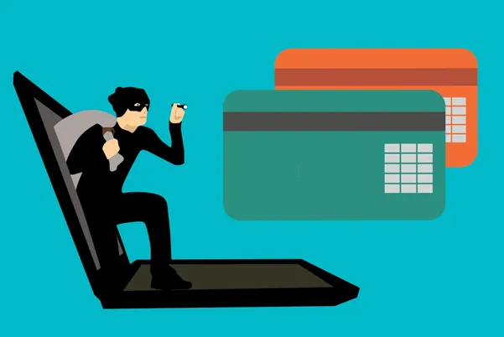
Credit Card Fraud Detection
Credit Card Fraud Detection
H. Efe Atakul
H. Efe Atakul
Img from Stockvault

Slide 2

Introduction
🎯Goal:
Utilizing predictive modeling on fraud detection in credit card transactions
Dataset:
Source: Worldline & ULB Machine Learning Group collab.
284k labeled transactions over 2 days
30 features (28 PCA + Time + Amount)
Imbalanced dataset - 0.17% fraud
Notes:
In this study we will use various predictive models and techniques to accurately detect whether a credit card transaction is a normal payment or fraud
- The dataset has been collected and analysed during a research collaboration of Worldline and the Machine Learning Group (http://mlg.ulb.ac.be) of ULB (Université Libre de Bruxelles) on big data mining and fraud detection. For further details about the dataset please refer to this Kaggle link

Slide 3
Project Summary
Data Preparation and Exploratory Analysis
Baseline Model Performance and Measurement Metrics
Outlier Detection
Feature Scaling
Strategies to Deal with Imbalanced Data
Feature Selection
Hyperparameter Tuning

Slide 4
Project highlights
Challenges
Outliers
High variance in certain features
Class imbalance
Correlation, collinearity

Slide 5
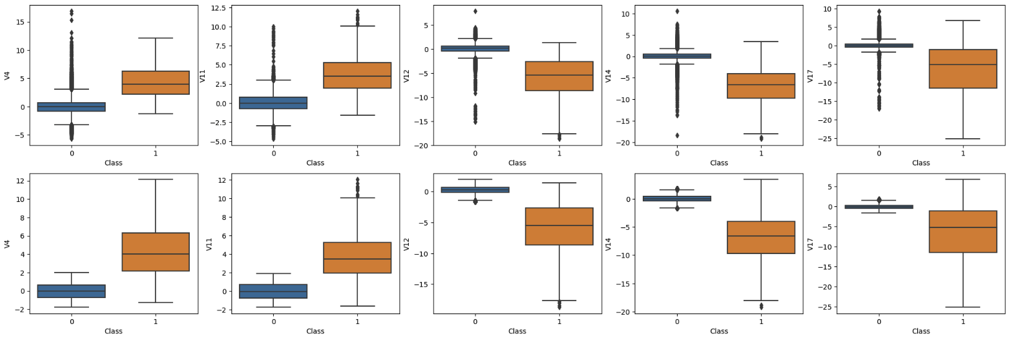

Project highlights
Challenges
Outliers
High feature variance
Class imbalance
Correlation, collinearity
$🛠️$Outlier Detection

Slide 6
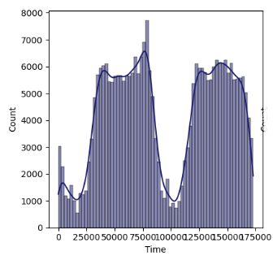
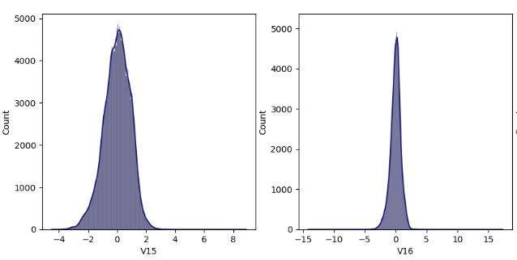


Project highlights
$🛠️$Outlier Detection
Challenges
Outliers
High variance in certain features
Class imbalance
Correlation, collinearity
$🛠️$Feature Scaling

Slide 7
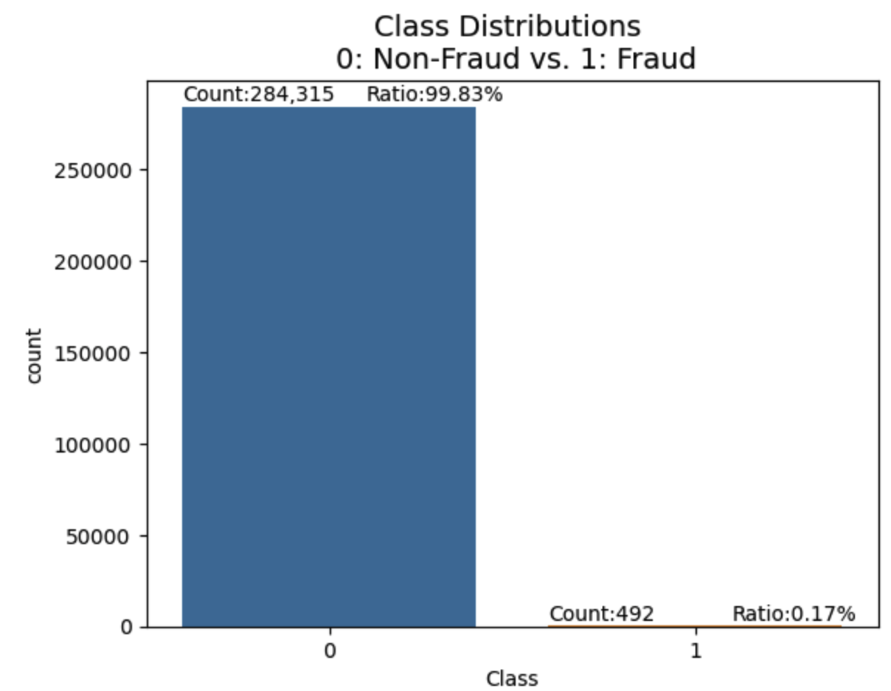

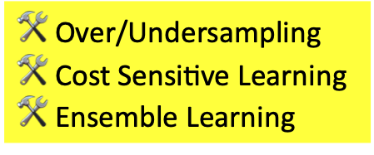

Project highlights
$🛠️$Outlier Detection
$🛠️$Feature Scaling
Challenges
Outliers
High feature variance
Class imbalance
Correlation, collinearity
$🛠️$Over/Undersampling $🛠️$Cost Sensitive Learning $🛠️$Ensemble Learning

Slide 8
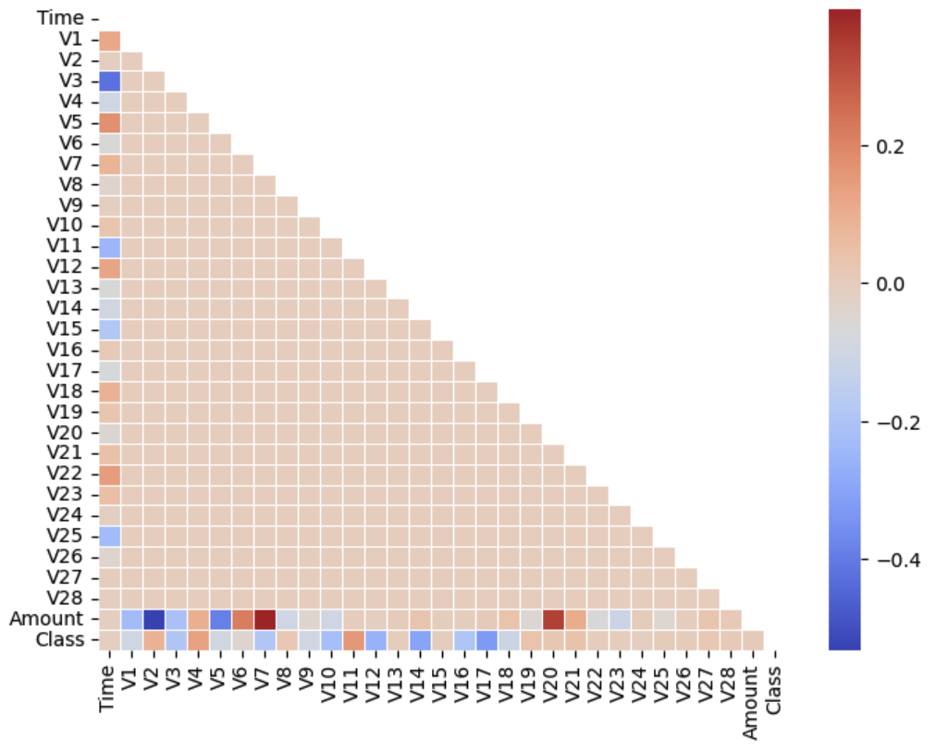
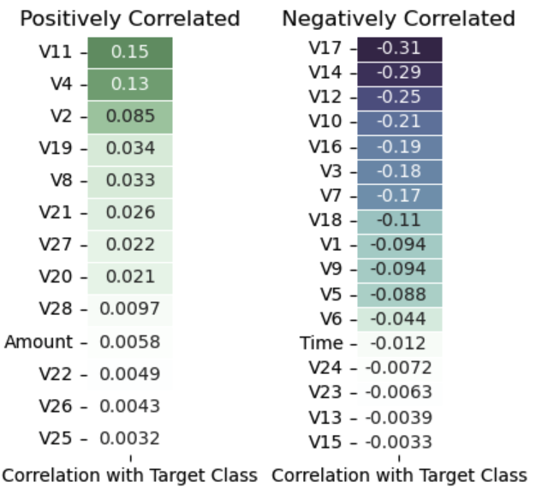
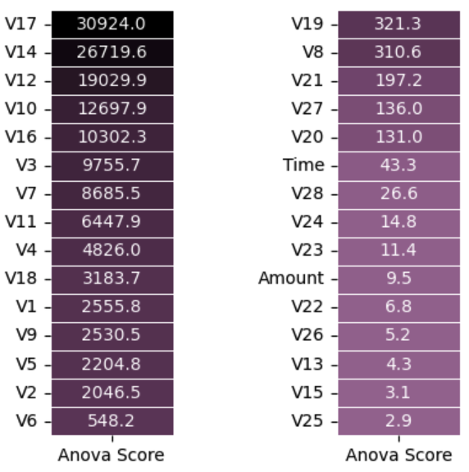



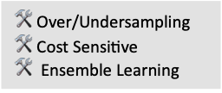
Project highlights
$🛠️$Outlier Detection
$🛠️$Over/Undersampling $🛠️$Cost Sensitive
$🛠️$Ensemble Learning
$🛠️$Feature Scaling
Challenges
Outliers
High feature variance
Class imbalance
Correlation, collinearity
Over/Undersampling Cost Sensitive learning Ensemble Learning
$🛠️$Feature Selection

